Slide 1
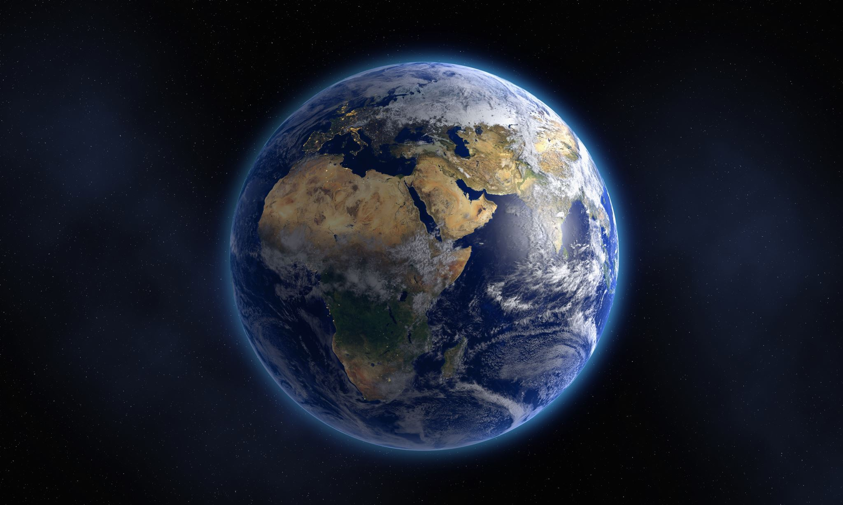
The Earth day
Veronika Staňková

Slide 2
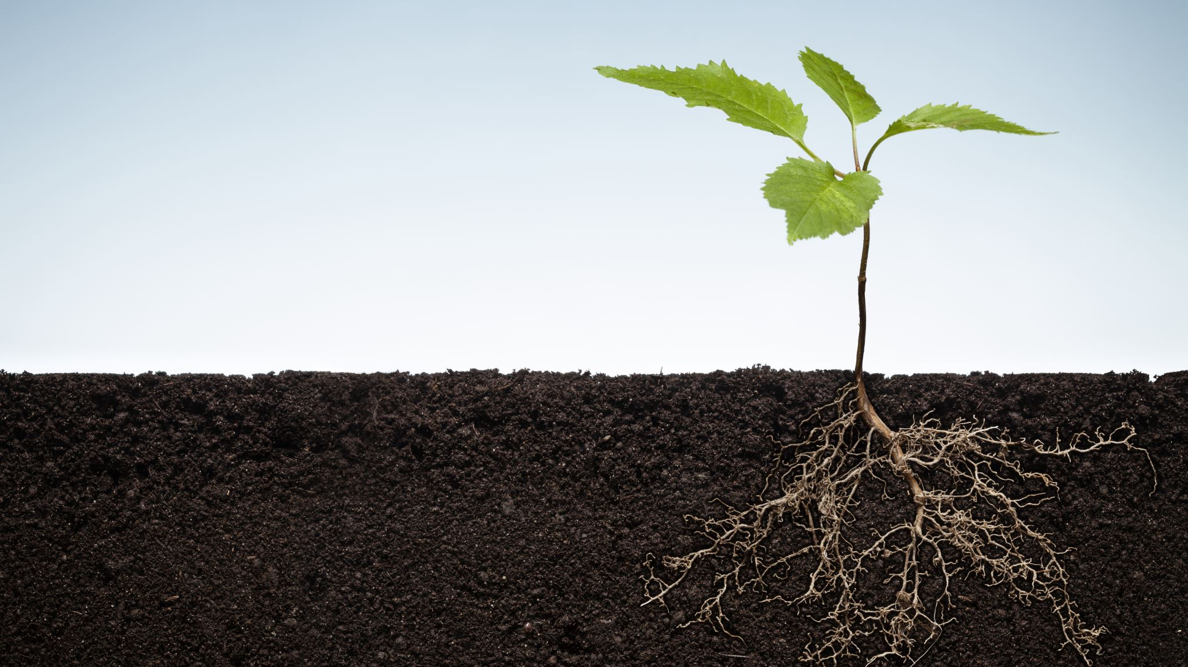
The Earth
The Earth is one of the planet from solar system,
It is the third planet from the Sun.
This planet is the fifth largest of the planets in the solar system.
The Earth is only one planet with water, oxygen and with life.

Slide 3
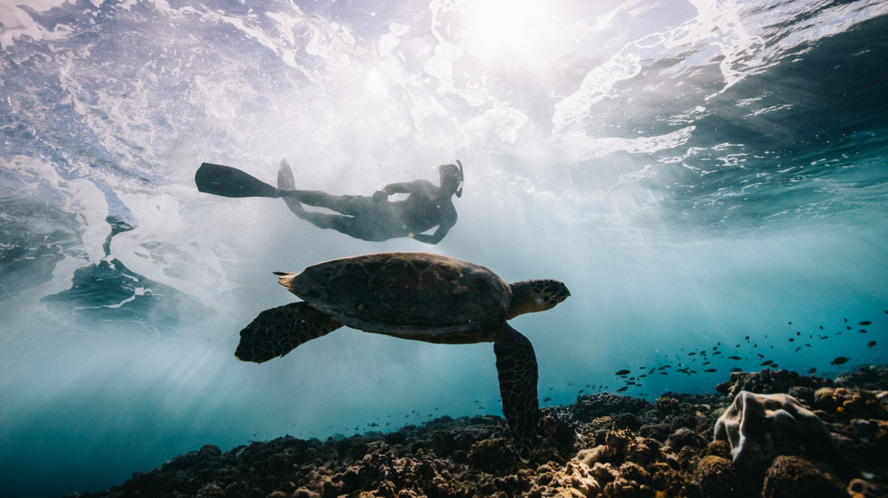
Pollution
Pollution is one of the bad things what people can do, because pollution is something like throwing the rubbish on the ground or wasting water and everything what destroys our planet.
This is I think the worst thing made by people because the Earth is their Mum and they destroy it. I think it is very cruel from them.

Slide 4
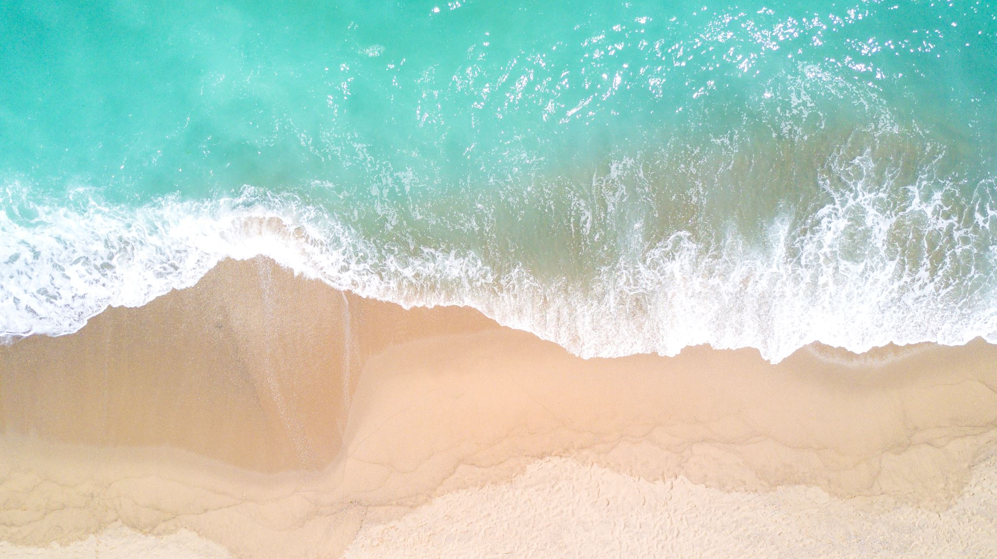
Rubbish in the sea or ocean
I think this is a very big problem, because in the sea there are a lot of animals, which need life like all of us and for example turtles or whales are here and the big problems are with wales, because they are very big, and they swim with open mouth and they catch their food. When they swim with open mouth, the problem is here because in the sea there are a lot of rubbish or plastic things and and they logically eat the rubbish too. This is problem because a lot of whales will die. So please when you have some rubbish, please throw it in a bin. It will save a lot of animals lives.

Slide 5
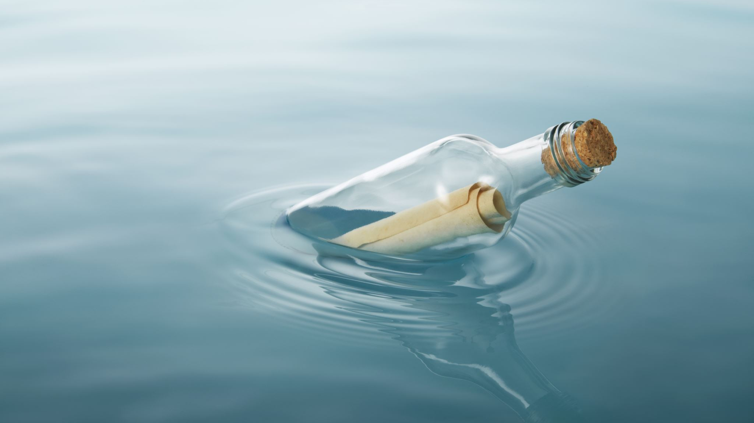
How to help our environment
We shouldn't waste water because if we waste water, our planet will be very dry and we will not have anything to drink.
We shouldn't throw the rubbish on the ground, because our planet will be very dirty and a lot of animals will be dead.
We should recycle everything which is possible to be recycled.
We should plant some plants or trees because a lot of people cut trees down and this is a very big problem because trees make oxygen for us and we need them for our life.
You should one day go and pick everything like rubbish from the ground. You'll have better feelings, because you help the earth and our planet will be cleaner.
You should reuse things.
You should use both sides of paper.

Slide 6
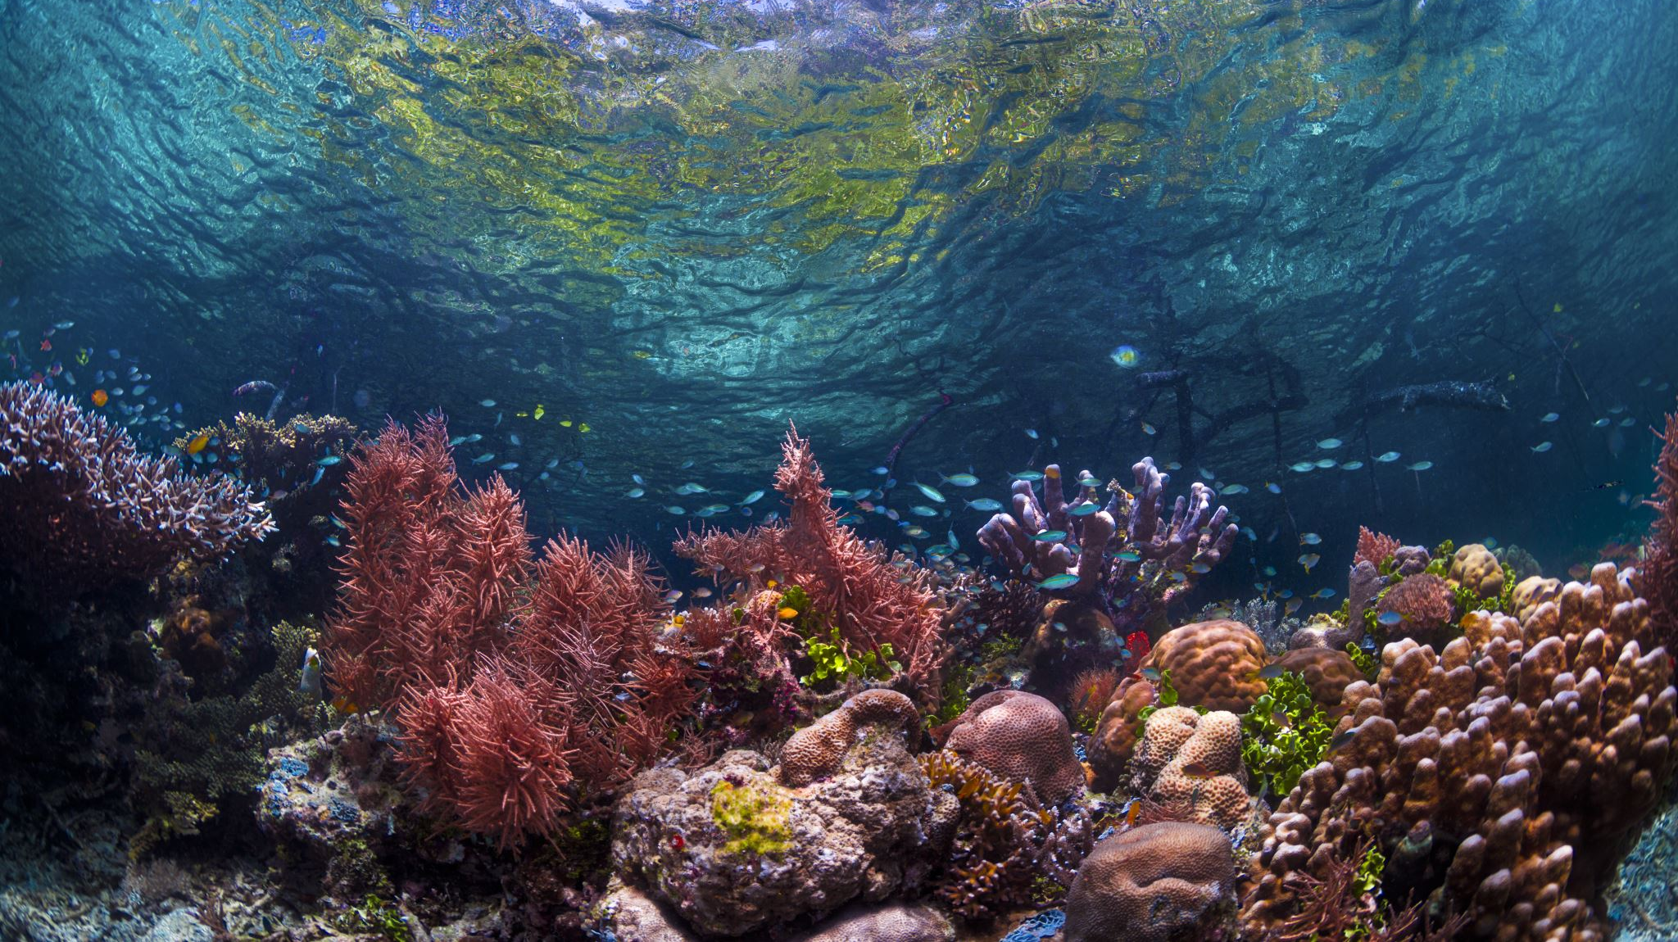
..but what if we don´t respect these rules?..
It is very easy…. our planet will be dirty, the nature will stop making an oxygen and we will die. But it will be our mistake because we have a lot of chances to save our planet now. We are the team and we can do it together.

Slide 7
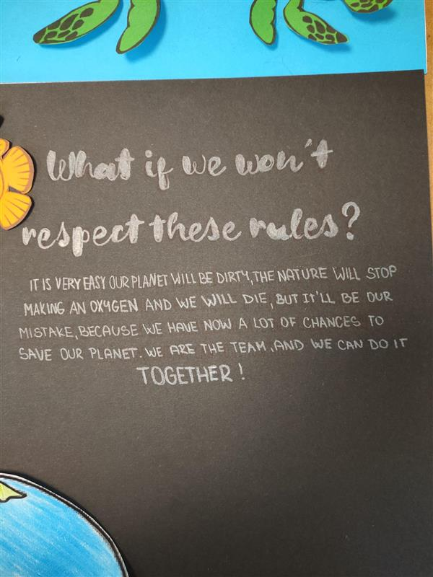
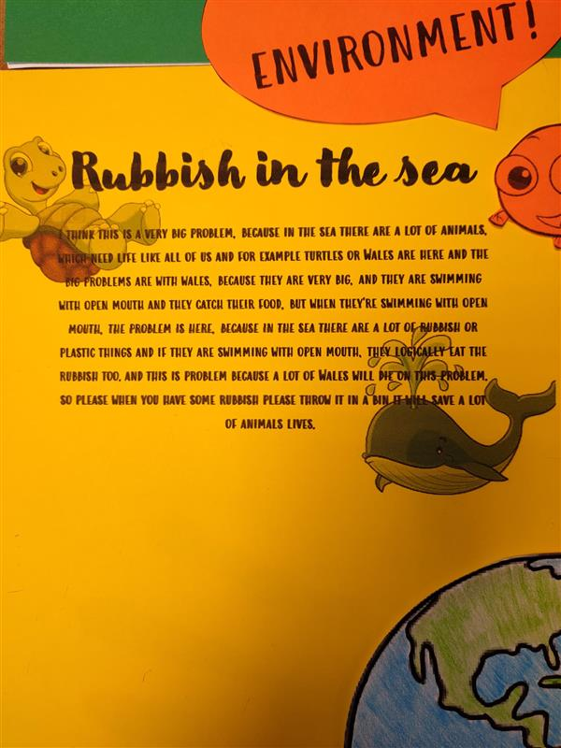
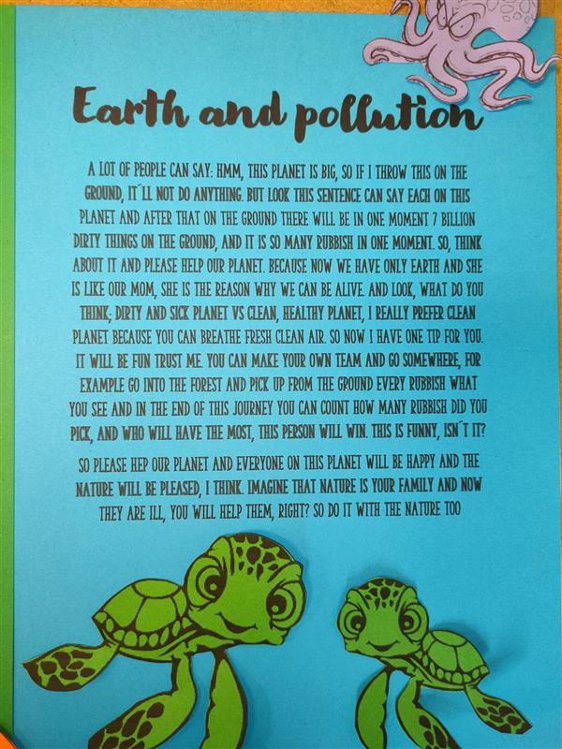
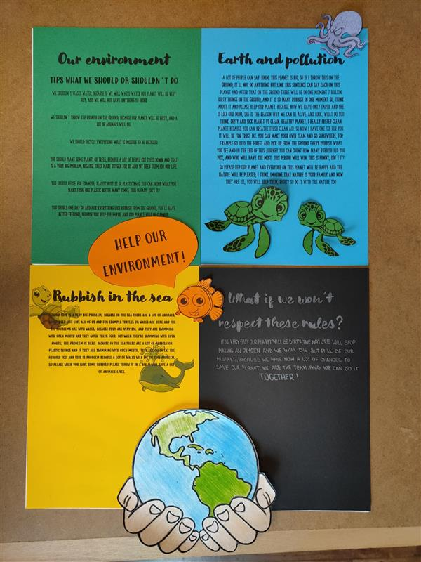
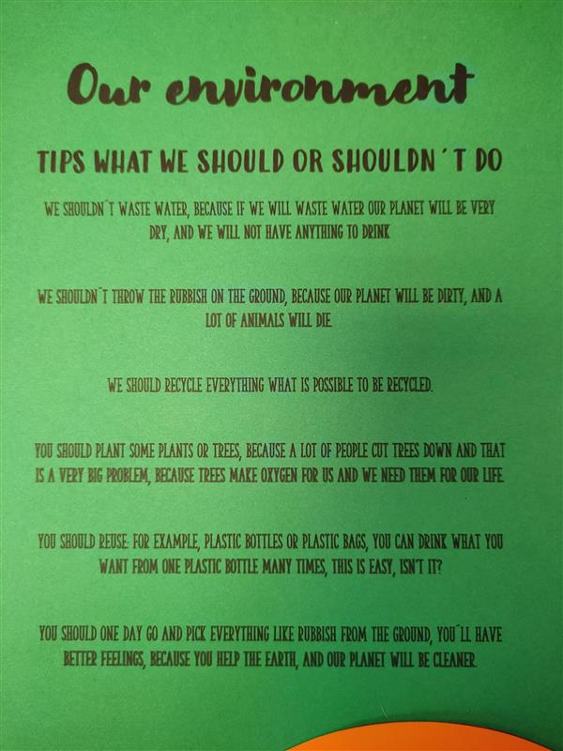
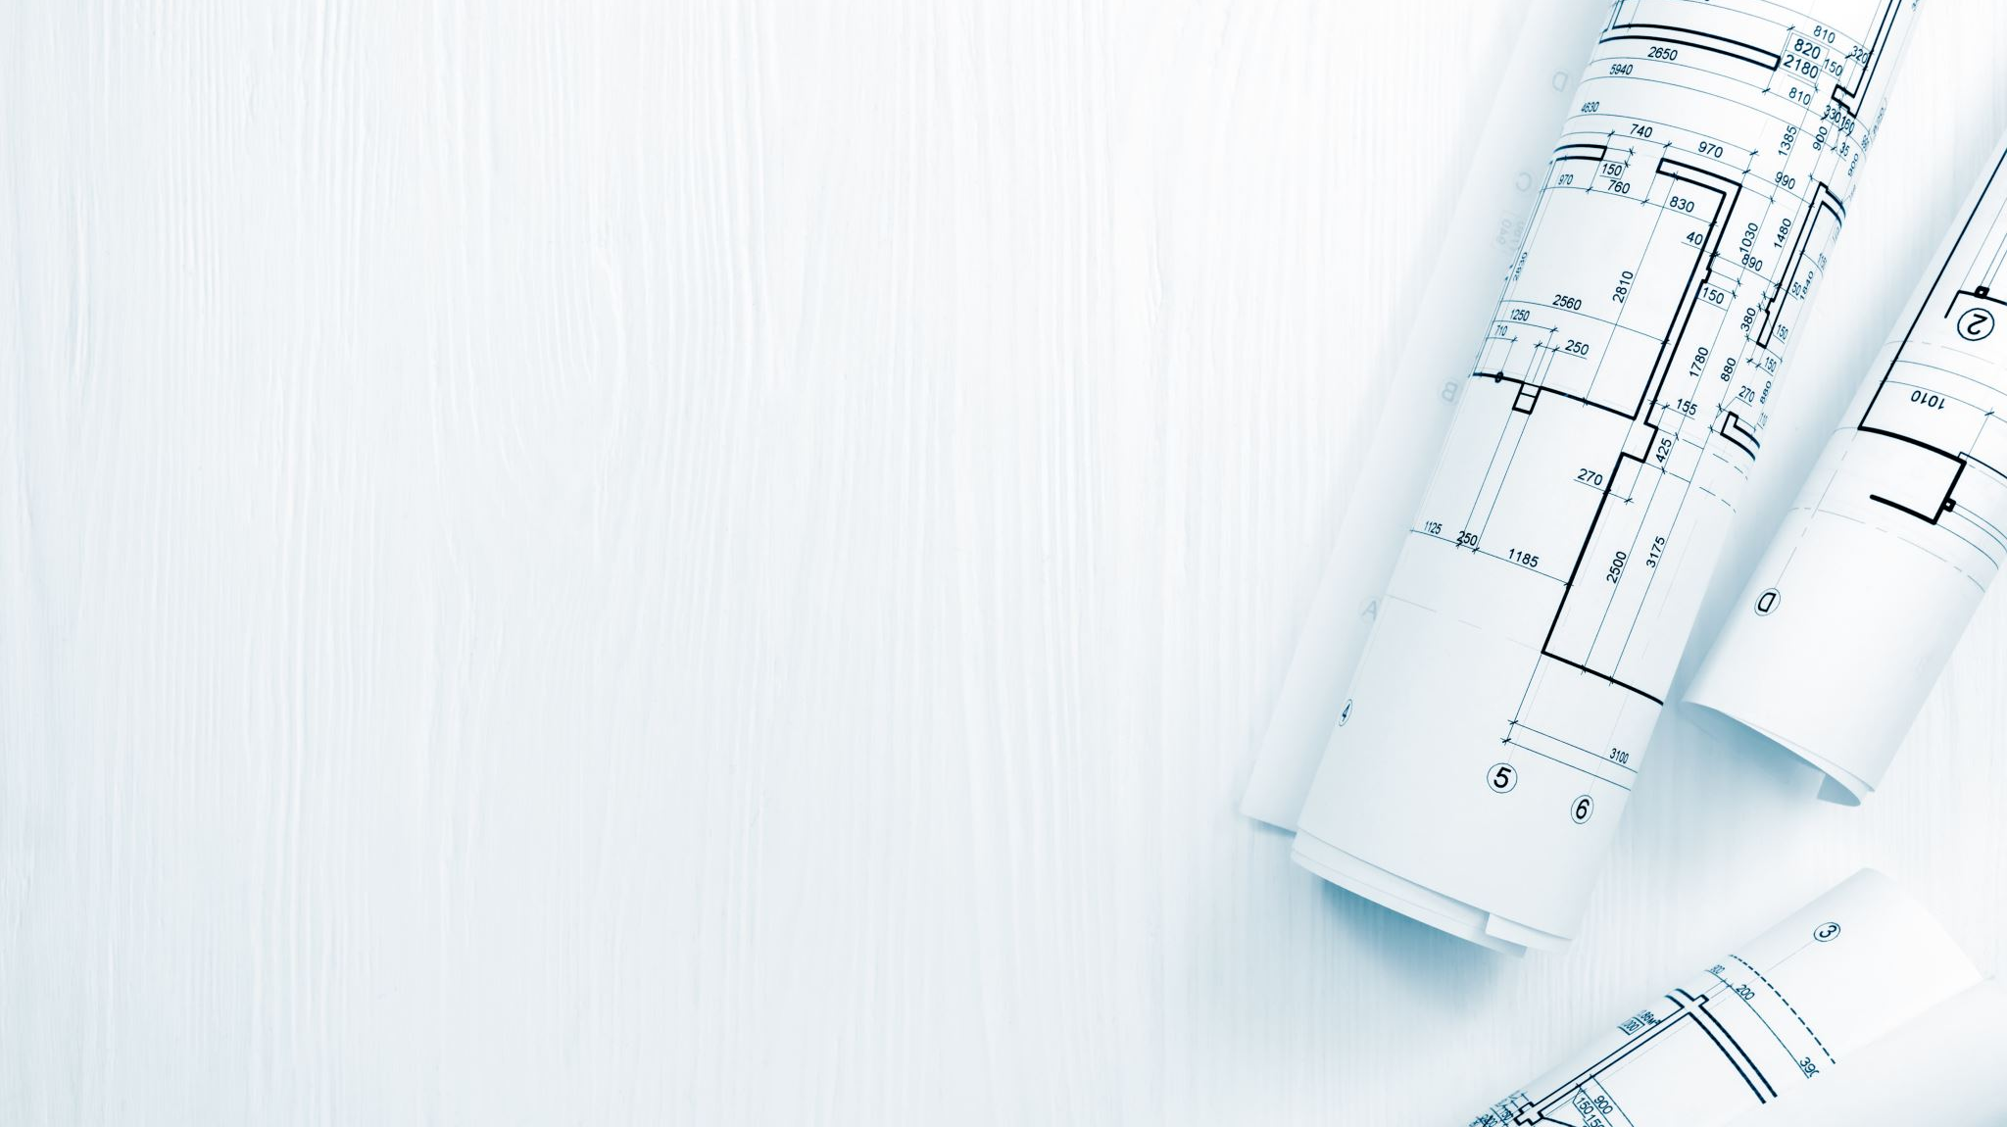
..And now my second project..
Here are some photos:

Slide 8
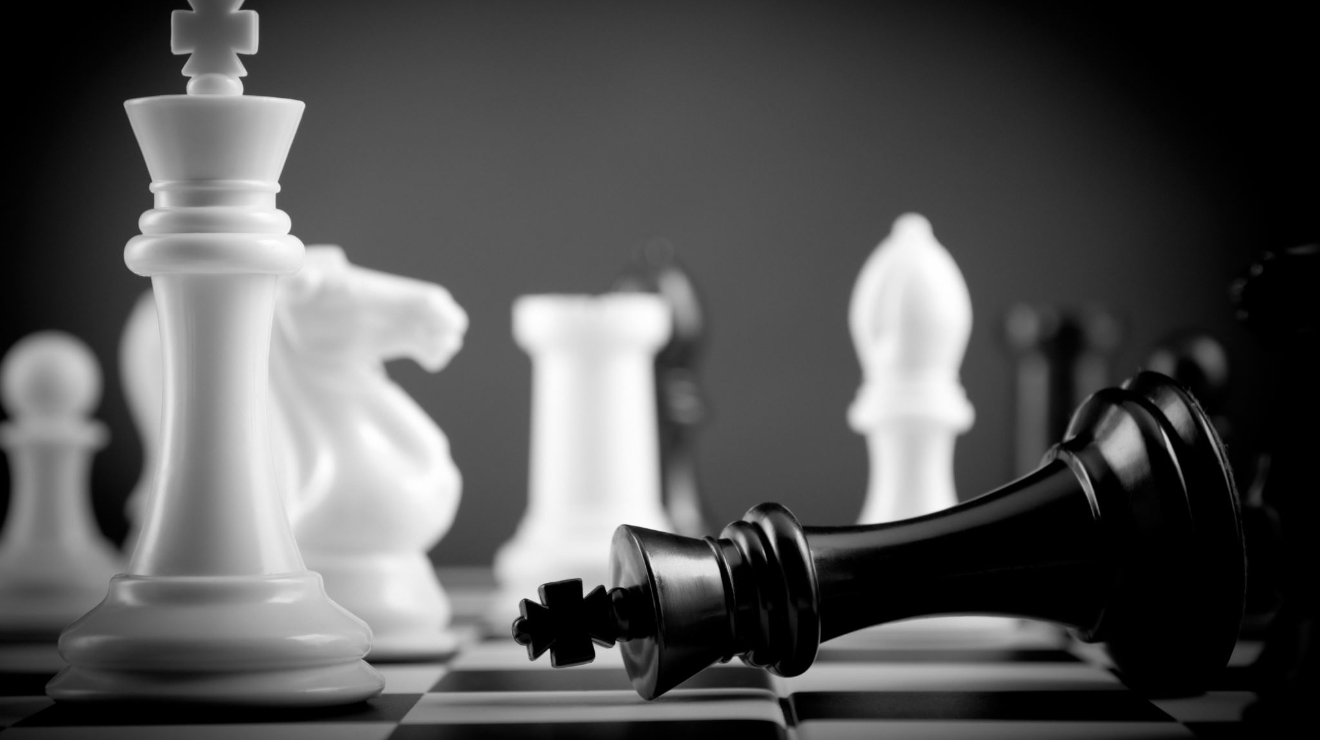
The end
I really hope that you enjoyed this presentation. I was really happy, when I was creating it for you. So thank you for watching this presentation. I think it is all from me <3

